Slide 1

A Data Analysis from the National Park Service
This analysis delves into data collected from four national parks, focusing on the species and their endangered status within each park. Each park shelters the same number of species, and each has the exact same number of species in each category (Concern, Endangered, Threatened, and In Recovery). Additionally, we gained insight into which species are most likely to be threatened and endangered.

Slide 2

Delving into the data
We collected information from four national parks, including species and their endangered status in each park.
Upon closer examination, we observed that each park shelters the same number of species and the exact same number of species in each category (Concern, Endangered, Threatened, and In Recovery).
Additionally, we gained insight into which species are most likely to be threatened and endangered.

Slide 7

Species in risk
We can notice a trend in some species, like amphibians and fish, which have a much higher risk of endangerment compared to others, like plants and mammals. More than 50% of amphibians are at severe risk, and 67% of fish are in the danger zone. Reptiles and birds lead in having the lowest danger levels, with less than 10% of birds and 0% of the reptiles analyzed being in danger.

Slide 14
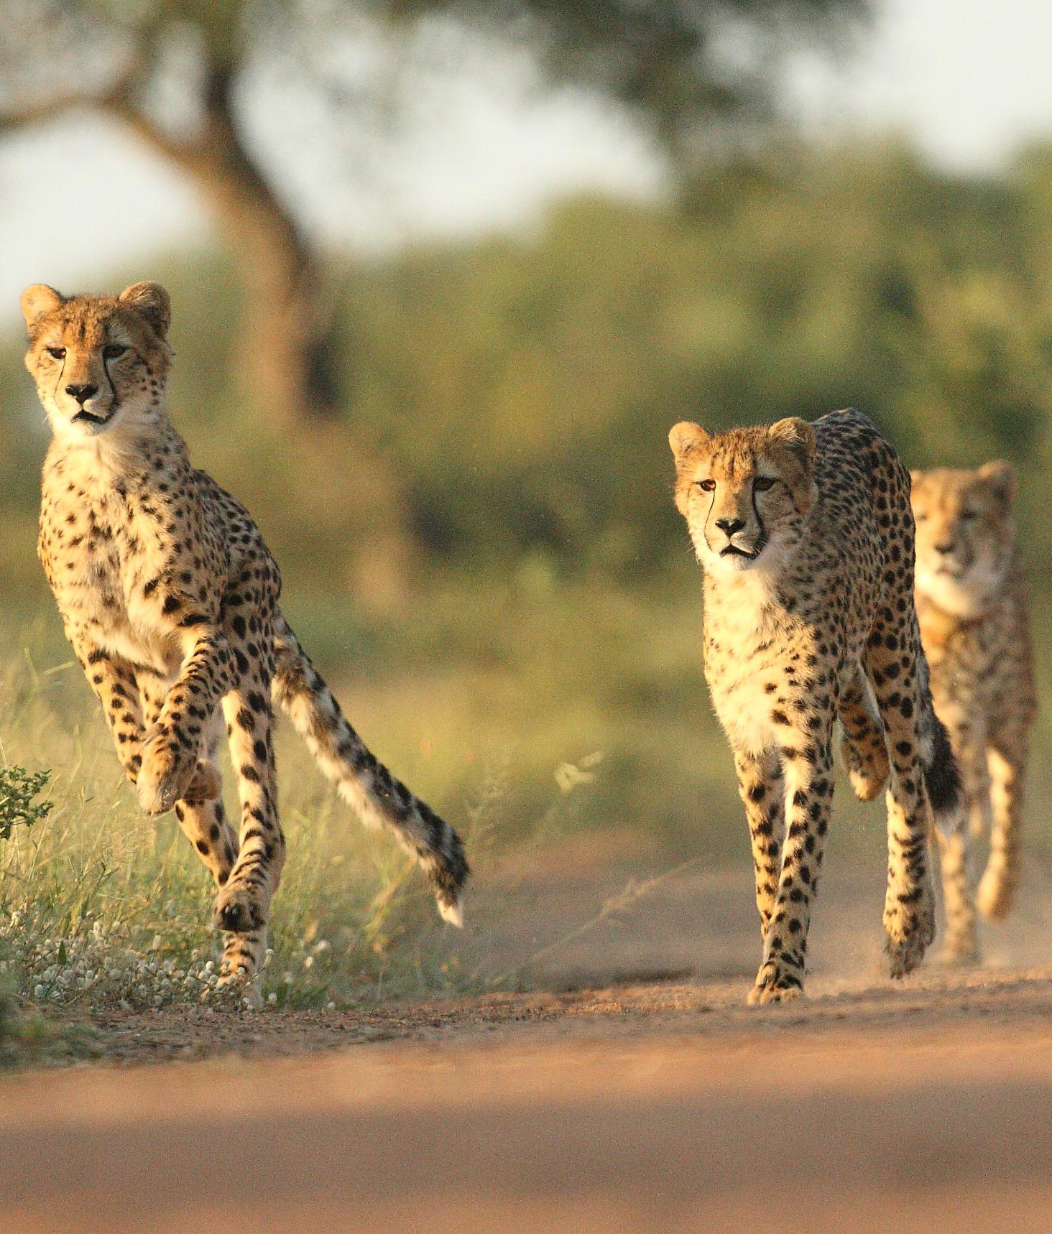
Conclusion
After deep look into the data, we notice the correlation between species and their conservation status.
We also observed how each park carefully houses the same number of species in each conservation status.
With data examples like this, we can start thinking about the greatness of our national biodiversity and the mission to protect it.

